Slide 1

CRICKET MATCH PREDICTION

Slide 2

INTRODUCTION:-
In this project we are however going to concentrate on a match prediction for T20 match format.
We predict the win percentage of the teams playing against each other based on the T20 cricket matches data from 2015. The factors such as playing XI, toss, bat first and venue play an important role in estimating the win percentage of a team
Team 1
Team 2
Toss Winner
Match Winner
.
.
.
.
Ground

Slide 3
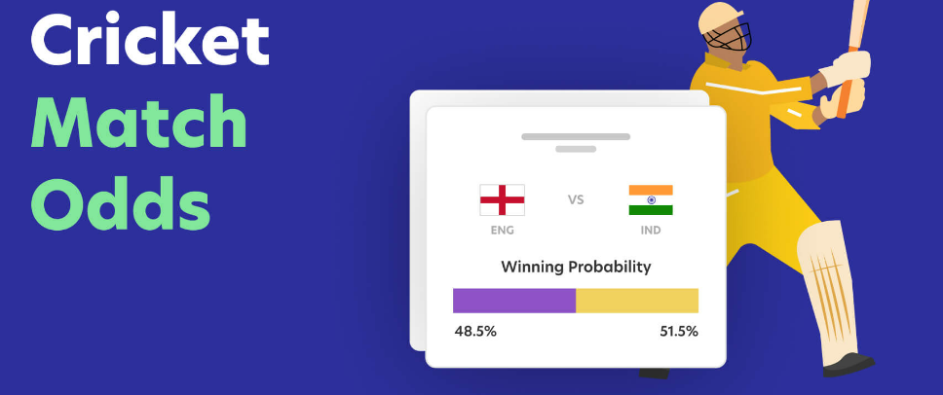
Motivation:
This project outcome will be very useful to the cricket match bookies and punters to set their odds and improve their decision making to set the stakes by leveraging the historic matches data
USERS:-
Bet365
Betway
1XBet
Other Individual Bookies and Punters

Slide 4
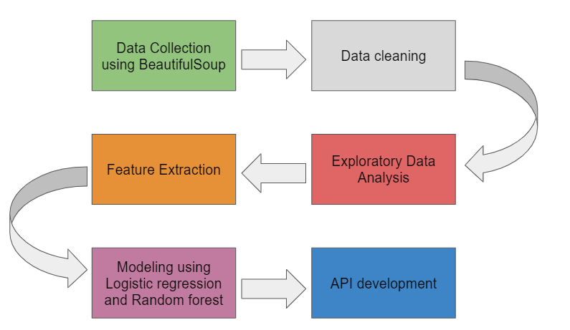
METHODOLOGY:
1
2
3
4
5
6

Slide 5
DATA COLLECTION PHASE I:
The main concept behind out data collection is Web scraping. We have scraped the data available publicly on the sport news website espncricinfo.com.
we have used the request library and the beautiful soup library available in python to perform the web scraping.
REQUEST
BEAUTIFUL SOUP
Team1
Scorecard Link
Team2
Winner
Margin
Ground

Slide 6
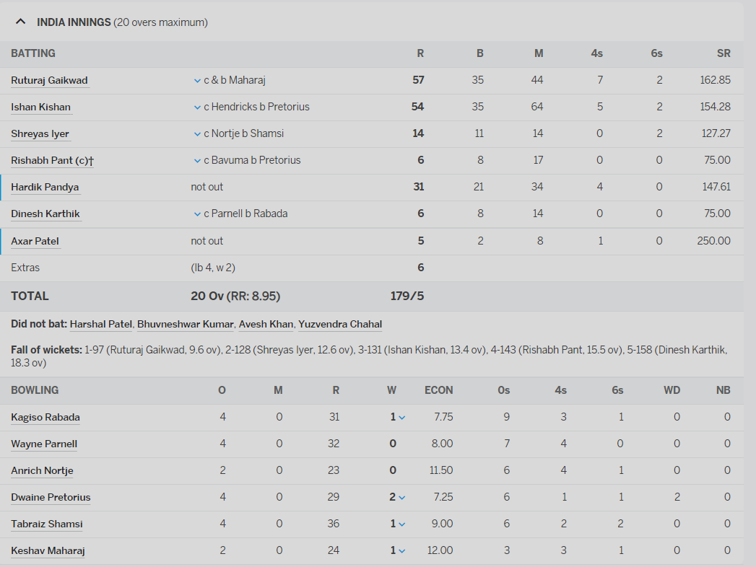

DATA COLLECTION PHASE II:
Extract Target, Toss Winner, Playing XI from Scorecard Link
TOSS (Span Tag)
Target (Span Tag)
Playing XI
collected information as Players batted in first innings and players bowled in first innings and the same is repeated for the second innings.

Slide 7

DATA CLEANING
Since we collected data from online website like ESPN, they also consisted of many missing values and matches with no information in toss, results, etc
Removing Null values
Removing Tied match
Cleaning scraped Data
Changing data types and formats

Slide 8
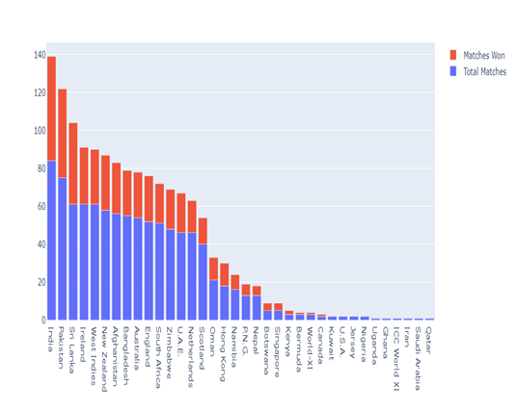
EXPLORATORY DATA ANALYSIS:-
Each teams total number of matches and number of the matches won on a stack bar chart.
Team | Total Matches | Total won matches
India | 84 | 55
Pakistan | 75 | 47
New Zealand | 58 | 29
Bangladesh | 55 | 21
Australia | 54 | 29
Afghanistan | 56 | 43
South Africa | 51 | 27
England | 52 | 30

Slide 9
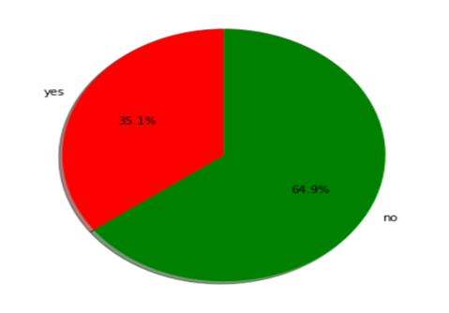
EXPLORATORY DATA ANALYSIS:-
percentage of winning the match when you won the toss. We have used the matplotlib pie chart with the inputs as Toss win and matches win by total number of matches.
There is 35% chance of winning the match if you win the match

Slide 10

FEATURE EXTRACTION:-
The main feature extraction we were able to do was to finding out the which team has batted first in the match.
If Team 1 won the toss and elected to bat then return Team 1.
If Team 1 won the toss and elected to field then return Team 2 .
If Team 2 won the toss and elected to bat then return Team 2.
If Team 2 won the toss and elected to field then return Team 1.
India Batted First

Slide 11
MODELING:
The modeling part for this project consist of two models. Initially we performed a One hot encoding on the data. This is because we wanted to find the winner of a match based on one of the factors called playing 11 and ground.
MODELLING with Grid Search
Accuracy
DATA FRAME WITH 1083 Columns
PCA
50 Columns
Logistic Regression
67%
Random Forest Classifier
88%

Slide 12
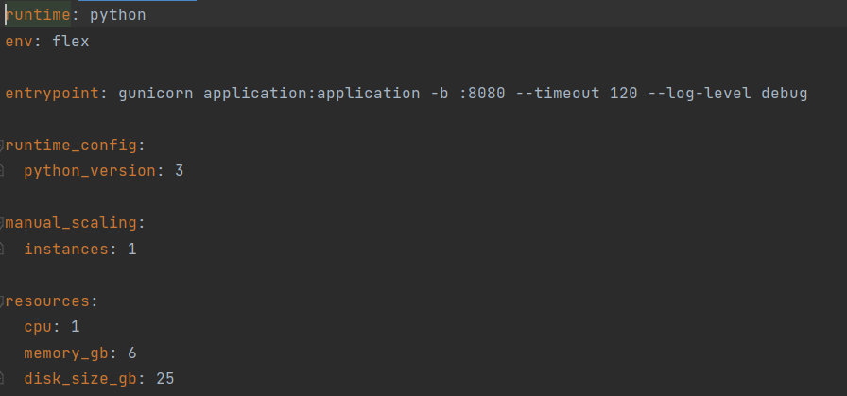
FLASK API:
Using Python decorators, you may create an API endpoint with the Flask web framework. First, we installed the flask framework and created an app that supports our project. The function match_prediction() was then given a decorator named app.route('/matchprediction'). This match_prediction() function activates our trained model with the supplied inputs to forecast the likelihood of both teams winning

Slide 13
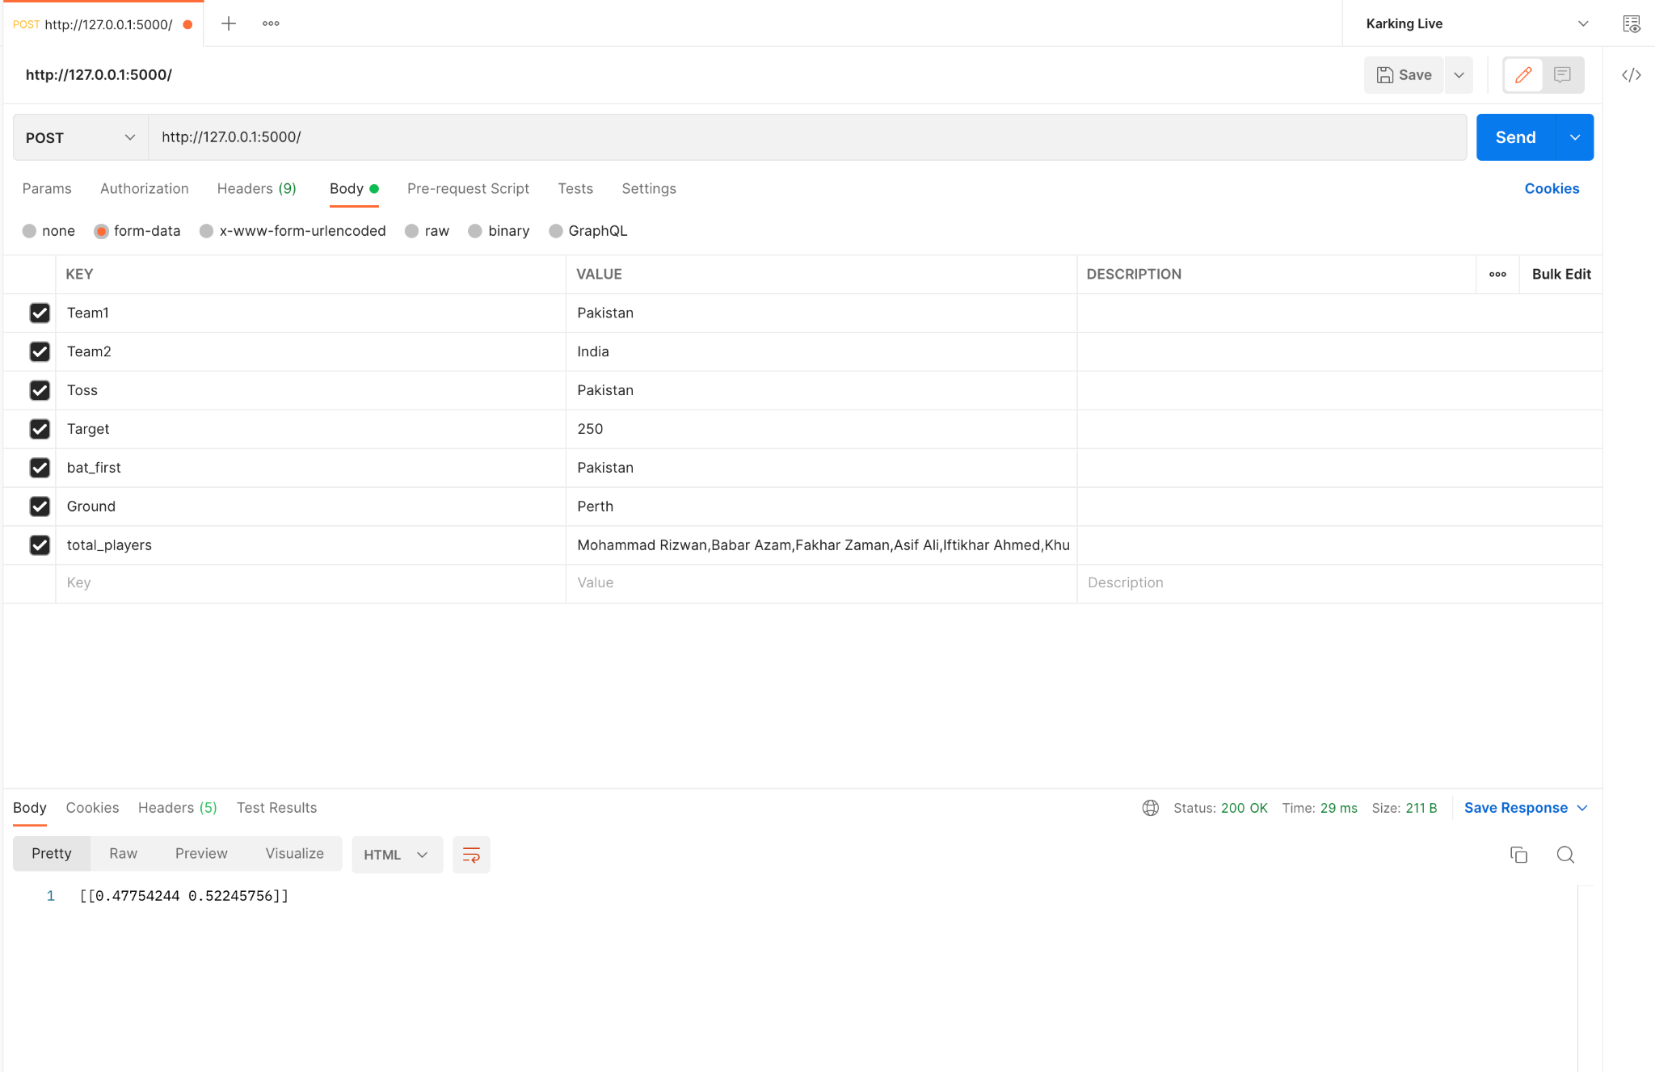
FINAL OUTPUT:

Slide 14
REFERENCES:
[1] Fahim Ahmed Shakil, A. H. (2020). Predicting the Result of a Cricket Match by Applying Data Mining Techniques. researchgate.
[2] Nilesh M. Patil, B. H. (2020). Cricket Team Prediction Using Machine Learning Techniques. SSRN.
[3] Sidharth Mishra, U. S. (2017). Principal Component Analysis . researchgate.
[4] Srikantaiah K C, B. K. (2021). Prediction of IPL Match Outcome Using Machine Learning Techniques. researchgate.

Slide 15
ANY QUESTIONS?

